Slide 1

Final Project
Supervised
Machine
Learning on
Adult Dataset

Slide 2

Contents
1
2
3
4
5
6
7
Project Topic
Data
Data Cleaning
Exploratory Data Analysis
Models
Results and Analysis
Discussion and
Conclusion

Slide 3

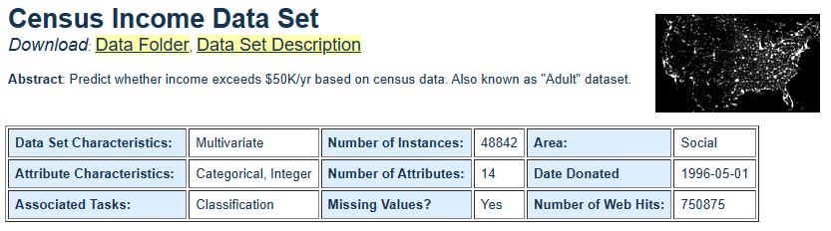
Project Topic
1
Task
Project task is to develop and create binary classification models.
Goals
Primary
Secondary
*

Slide 4


2
Data
Data Source
https://archive.ics.uci.edu/ml/datasets/Census+Income
Data Description
Characteristics of dataset.
Data Attributes
Information of attributes.
Data Summary
Checking the summary of data.

Slide 5

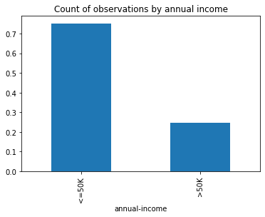

3
Data Cleaning
Missing Values
Check of Imbalanced Data
Conclusion
na_values='?' is the argument used while reading in dataset.
We will first clean target variable.

Slide 6

4
Exploratory Data Analysis
* Refer to notebook for EDA and visualizations.

Slide 7

Multicollinearity?
We check for dependency between marital status and relationship.
Multicollinearity Test
It’s best if you keep your text within 3-5 lines. Less is more!
Synthetic Minority Oversampling Technique
We use SMOTE to balance our dataset by over-sampling the minority class.
Encoding Categorical Variables
We represent annual income of >50K as 1 and <=50K as 0.
5
Models
Standardizing Feature Set
We standardize the age, hours-per-week and
Train-Test Split
We will divide the dataset into a 70:30 ratio.

Slide 8
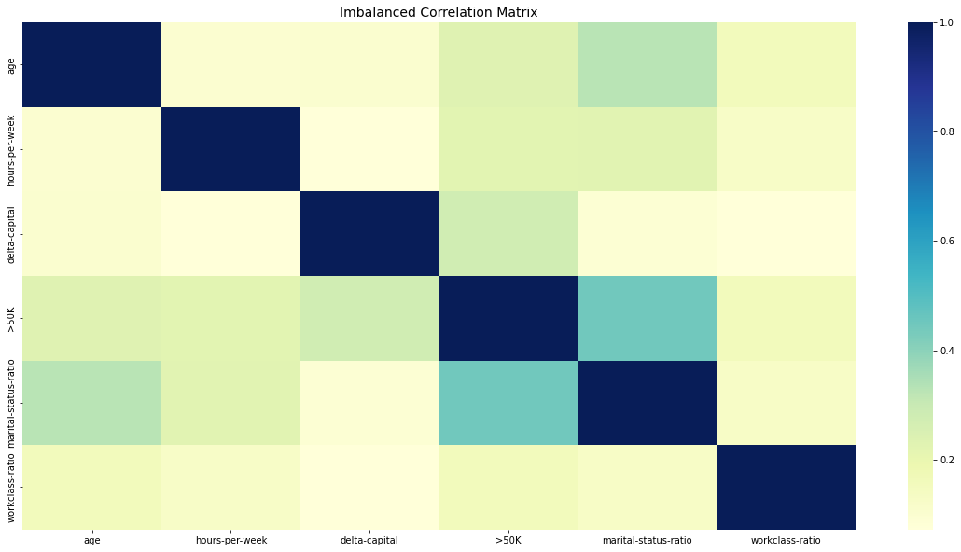
SMOTE: Synthetic Minority Oversampling Technique

Slide 9
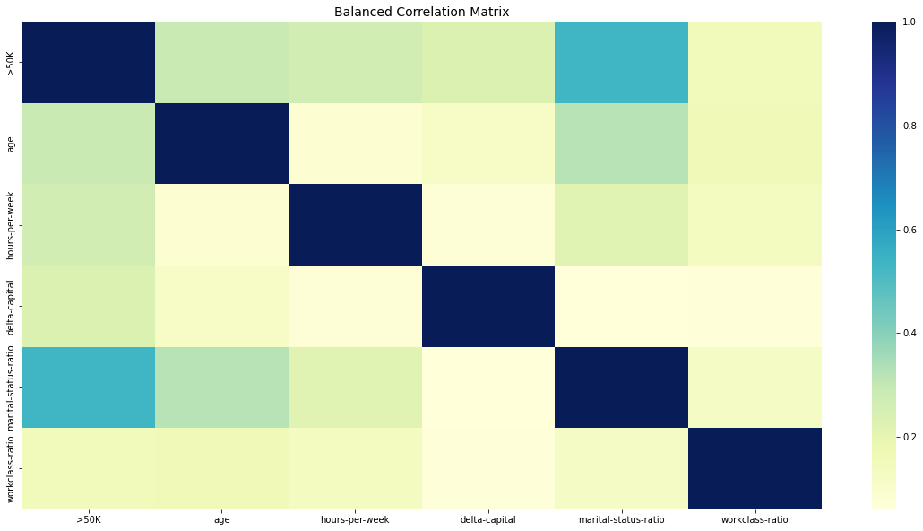

Slide 10
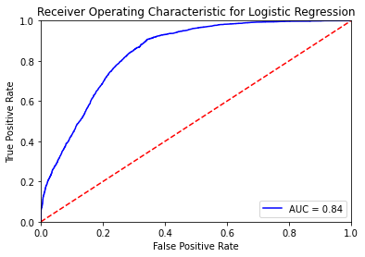
Evaluation Metric
Logistic Regression (with SMOTE)
Logistic Regression

Slide 11
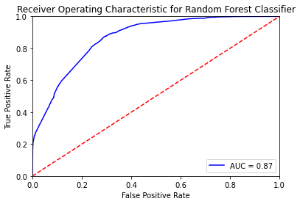

Random Forest Classifier (SMOTE)
Random Forest Classifier

Slide 12
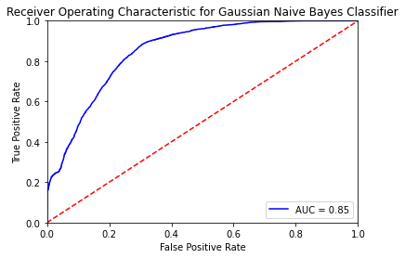

Gaussian Naive Bayes (SMOTE)
Gaussian Naive Bayes

Slide 13
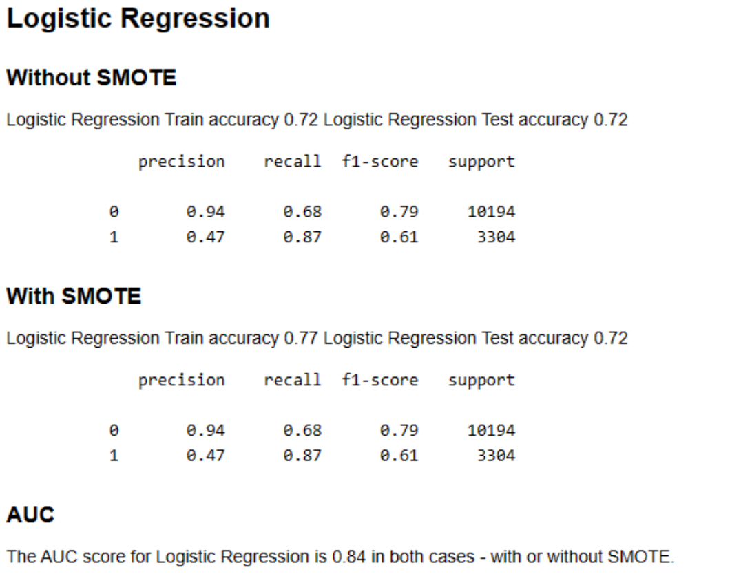
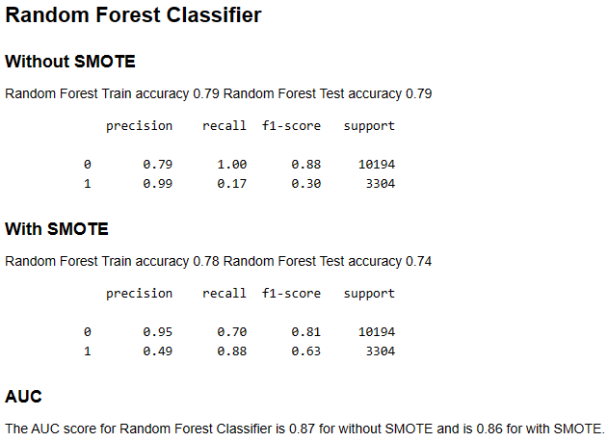
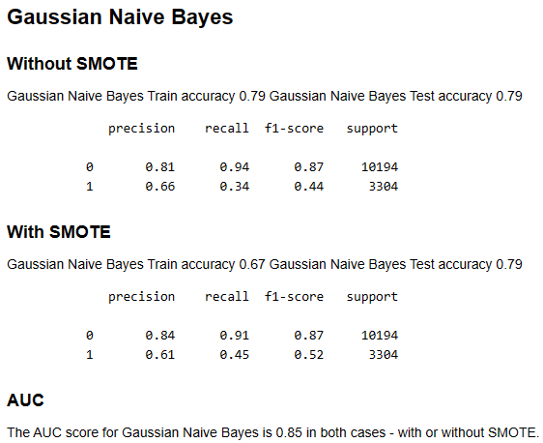
Results and Analysis

Slide 14

Discussion and Conclusion
Data cleaning is crucial for machine learning pipeline.
Exploratory Data Analysis is critical to identify the most significant factors.
Statistical tests can easily identify the patterns and develop a solid feature set.
Handling of imbalanced dataset is challenging.
Accuracy may not be the best metric all the time.
AUC score provides a better understanding for model performance when the dataset is imbalanced.
Reference: Dua, D. and Graff, C. (2019). UCI Machine Learning Repository [http://archive.ics.uci.edu/ml]. Irvine, CA: University of California, School of Information and Computer Science.

